Slide 1

Data Structures and its Applications
Dinesh Singh
Department of Computer Science & Engineering

Slide 2

Data structures and its applications
Dequeue - Implementation
Dinesh Singh
Department of Computer Science & Engineering

Slide 3
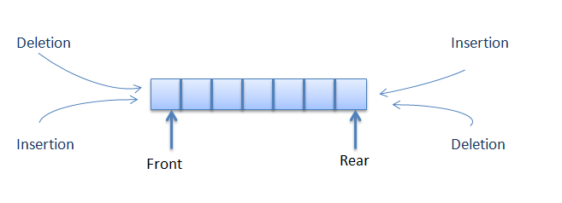
Data Structures and its Applications
Dequeue(Double ended Queue) - definition
Double ended queue is a queue that allows insertion and deletion at both ends.

Slide 4
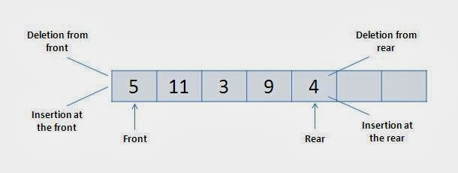
Data Structures and its Applications
Dequeue(Double ended Queue) - definition
The following four basic operations are performed on dequeue:
insertFront(): Adds an item at the front of Deque.
insertRear(): Adds an item at the rear of Deque.
deleteFront(): Deletes an item from front of Deque.
deleteRear(): Deletes an item from rear of Deque.

Slide 5
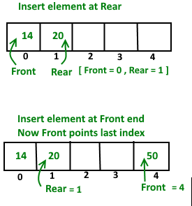
Data Structures and its Applications
Dequeue(Double ended Queue) - Array Implementation
Insert Elements at Rear end :
Check whether the queue is full
If rear = size-1
initialise rear to 0.
else
increment rear by 1
insert element at location rear
Insert element front end
Check if the queue is full
If Front =0
move front to last location (size -1)
else
decrement front by 1
insert at location front

Slide 6
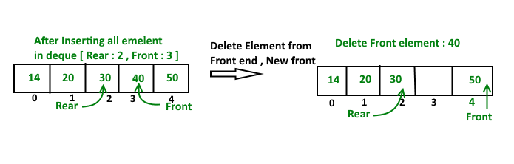
Data Structures and its Applications
Dequeue(Double ended Queue) - Array Implementation
Delete element at Rear end
check if the queue is empty
delete the element pointed by rear
If dequeue has one element
front=-1 rear=-1;
If rear is at first index
make rear = size-1
else
decrease rear by 1
Delete element at front end
check if the queue is empty
delete the element pointed by front
If dequeue has one element
front=-1 rear=-1;
If front is at last index
make front = 0
else
increase front by 1

Slide 7
Data Structures and its Applications
Dequeue(Double ended Queue) - Doubly Linked list Implementation
Structure of Dequeue
struct dequeue
{
struct node * front;
struct node * rear;
};
struct node
{
int data;
struct node * prev, *next;
};
struct dequeue dq;
dq.front=dq.rear = NULL

Slide 8
Data Structures and its Applications
Dequeue(Double ended Queue) - - Doubly Linked list Implementation
//insert in front of the queue
void qinsert_head(int x,struct dequeue *dq)
{
struct node *temp;
temp=(struct node*)malloc(sizeof(struct node));
temp->data=x;
temp->prev=temp->next=NULL;
if(dq->front==NULL) // first element
dq->front=dq->rear=temp;
else
{
temp->next=dq->front; // insert in front
dq->front->prev=temp;
temp->prev=NULL;
dq->front=temp;
}
}

Slide 9
Data Structures and its Applications
Dequeue(Double ended Queue) - - Doubly Linked list Implementation
//insert at the rear of the queue
void qinsert_tail(int x,struct dequeue* dq)
{
struct node *temp;
temp=(struct node*)malloc(sizeof(struct node));
temp->data=x;
temp->prev=temp->next=NULL;
if(dq->front==NULL)
dq->front=dq->rear=temp;
else
{
dq->rear->next=temp;
temp->prev=dq->rear;
dq->rear=temp;
}
}

Slide 10
Data Structures and its Applications
Dequeue(Double ended Queue) - - Doubly Linked list Implementation
//delete at the front of the queue
int qdelete_head(struct dequeue* dq)
{
struct node *q;
int x;
if(dq->front==NULL)
return -1;
q=dq->front;
x=q->data;
if(dq->front==dq->rear)//only one node
dq->front=dq->rear=NULL;
else
{
dq->front=dq->front->next;
dq->front->prev=NULL;
}
free(q);
return x;
}

Slide 11
Data Structures and its Applications
Dequeue(Double ended Queue) - - Doubly Linked list Implementation
//delete at the rear of the queue
int qdelete_tail(struct dequeue* dq)
{
struct node *q;
int x;
if(dq->front==NULL)
return -1;
q=dq->rear;
x=q->data;
if(dq->front==dq->rear)//only one node
dq->front=dq->rear=NULL;
else
{
dq->rear=dq->rear->prev;
dq->rear->next=NULL;
}
free(q);
return x;
}

Slide 12
THANK YOU
Dinesh Singh
Department of Computer Science & Engineering
dineshs@pes.edu
+91 8088654402

